Slide 1















Digital Portf olio
STUDENT NAME: DI VYA A
REGI STER NOAND NMI D: asunm101222400088
DEPARTMENT: Bsc Compter science
COLLEGE: COLLEGE/ UNI VERSI TY: RAJESWARI VEDHACHALAM
GOVT COLLEGE MADRASUNI VERSI TY.
1

Slide 2

PROJECT TI TLE
Personal digital portf olio website
2

Slide 3





AGENDA
1. Problem Statement
2. Proj ect Overview
3. End Users
4. Toolsand Technologies
5. Portf olio design and
Layout
6. Featuresand
Functionality
7. Resultsand Screenshots
8. Conclusion
9. Github Link
3/21/2024 Annual Review
3

Slide 4

PROBLEMSTATEMENT
*I n the competitive j ob market, students
and prof essional of ten struggle to showcase this
skills,proj ect,and achievement in an organization
and visually appearing manner.
4

Slide 5

PROJECT OVERVI EW
*A digital portf olio isan online platf orm showcasing
an individual’sskills, achievements, education, proj ects,
and experiencesin a visually appealing and interactive
way.
*I t servesasa prof essional identity, allowing
employers, educators, and peersto explore one’s
capabilitiesthrough a single, well- structured interf ace
* To provide a modern and easily accessible showcase
of personal and prof essional accomplishments.
5

Slide 6

WHOARE THE ENDUSERS?
*Students– to showcase academic
achievementsand proj ects.
*Job Seekers– to present skills,
resumes, and work samplesto employers.
*Employers– to reviewcandidate
profilesand evaluate skills.
*Educator– to assessstudent
progressand portf olio quality.
6

Slide 7

TOOLSAND TECHNI QUES
HTML, JavaScript – f or website design.
CSS– f or responsive layout.
GitHub Pages– f or hosting the website.
Git & GitHub – f or version control.
7

Slide 8

POTFOLI ODESI GNAND LAYOUT
*Clean and Prof essional Look – simple and neat
design.
*Home Page – short introduction and profile
photo.
*About Section – personal detailsand career
goals.
*SkillsSection – list of technical and sof t skills.
*Proj ectsSection – showcase of completed works.
*Contact Page – email, phone, and social links.
*Responsive Layout – workson mobile, tablet,
and desktop.
8

Slide 9
FEATURESAND FUNCTI ONALI TY
*Add Blog Section – to share experiencesand
learning.
*I ntegration with LinkedI n & GitHub – f or
prof essional networking.
*Dark Mode & Themes– to improve user
experience.
*AI - based Suggestions– to improve content and
design.

Slide 10
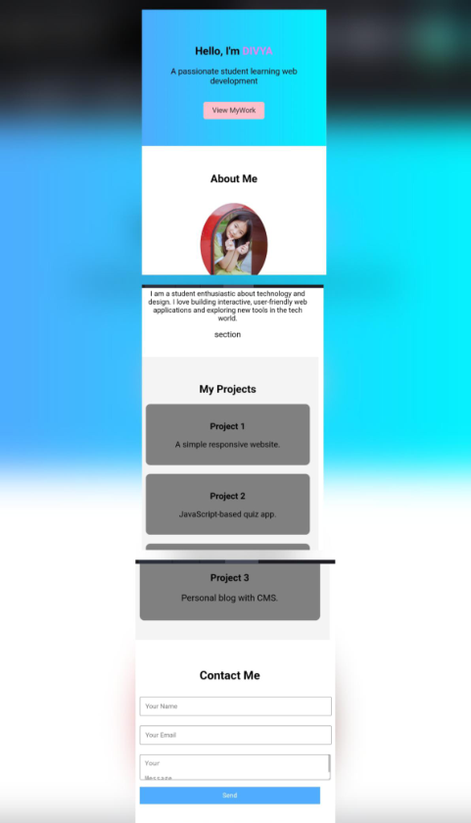

RESULTSAND SCREENSHOTS
3/21/2024 Annual Review
10

Slide 11
CONCLUSI ON
*A digital portf olio isan ef f ective way to
showcase skills, proj ects, and
achievements.
*I t helpsstudentsand prof essionals
create a strong online presence.
*Enhancescareer opportunitiesand
personal
11

